Slide 1

Chapter 2
Network Models
2.<number>
Copyright © The McGraw-Hill Companies, Inc. Permission required for reproduction or display.

Slide 2
2-1 LAYERED TASKS
We use the concept of layers in our daily life. As an example, let us consider two friends who communicate through postal mail. The process of sending a letter to a friend would be complex if there were no services available from the post office.
Topics discussed in this section:
Sender, Receiver, and Carrier
Hierarchy
2.<number>

Slide 3
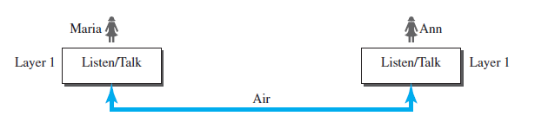
Single layer protocol
Maria and Ann are having a face-to-face conversation.
Certain protocols (etiquette) are followed –
  greeting each other
  choosing proper vocabulary
  listen when the other person is talking
  engage in a dialog not a monologue
  exchange parting remarks/goodbye
2.<number>

Slide 4

Figure 2.1 Tasks involved in sending a letter
Three layer protocol
2.<number>

Slide 5
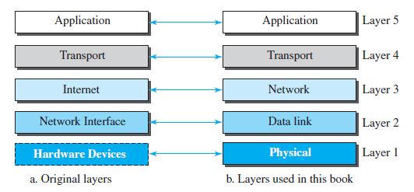
TCP/IP PROTOCOL SUITE
TCP – Transmission control protocol
IP – Internet protocol
TCP/IP protocol suite – set of hierarchical protocols (each upper layer protocol is supported by one or more lower-level protocols)
2.<number>

Slide 6
Communication using the TCP/IP protocol
Sender
Receiver
Communication channel
2.<number>

Slide 7
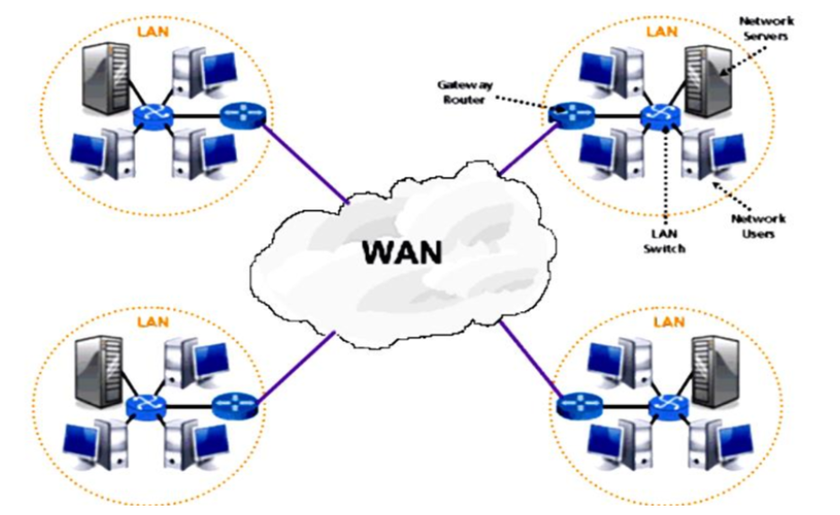
Communication using the TCP/IP protocol
2.<number>

Slide 8
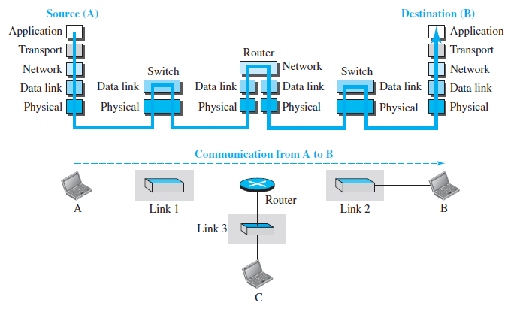
Communication using the TCP/IP protocol
2.<number>

Slide 9
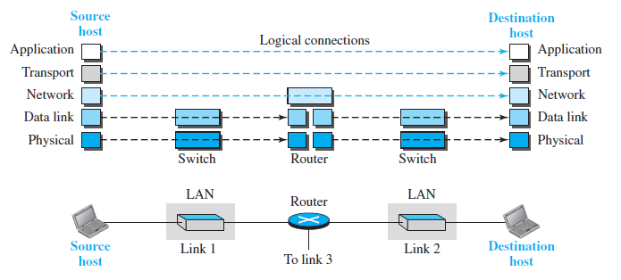
Logical connection in the TCP/IP protocol
Duties of the application, transport and network layers – end-to-end
Duties of the data link and physical layers – hop-to-hop
2.<number>

Slide 10
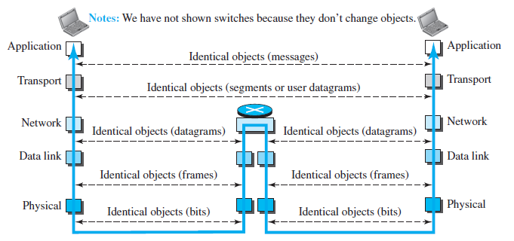
Logical connection in the TCP/IP protocol
2.<number>

Slide 11
Roles of layers in the TCP/IP protocol
Physical layer
Representation of information as sequence of bits.
Conversion of bits to signals for transmission across a communication channel.
Data Link layer
Delivery within a network.
Encapsulation of datagram into a frame.
No specific protocol defined for the data link layer.
2.<number>

Slide 12
Roles of layers in the TCP/IP protocol
Network layer
Host-to-host communication, routing of packets.
Protocols defined
  Internet Protocol (IP) – main protocol
    Defines format of datagram, format and structure of network address/
    Routing of packets
    Connectionless protocol, provides no error, flow or congestion control.
    Support for unicast and multicast routing.
  ICMP (Internet Control Message Protocol)
  IGMP (Internet Group Management Protocol)
  DHCP (Dynamic Host Configuration Protocol)
  ARP (Address Resolution Protocol)
2.<number>

Slide 13
Roles of layers in the TCP/IP protocol
Transport layer
Process-to-process delivery
Protocols defined
  TCP (Transmission control protocol)
    Connection oriented (virtual connection)
    Provides error, flow or congestion control.
  UDP (User datagram protocol)
    Connectionless
    No error, flow or congestion control.
  SCTP (Stream control transmission protocol)
2.<number>

Slide 14
Roles of layers in the TCP/IP protocol
Application layer
Generation of messages, interface between user and system
Protocols defined
  HTTP
  SMTP
  FTP
  TELNET
  SSH
2.<number>

Slide 15
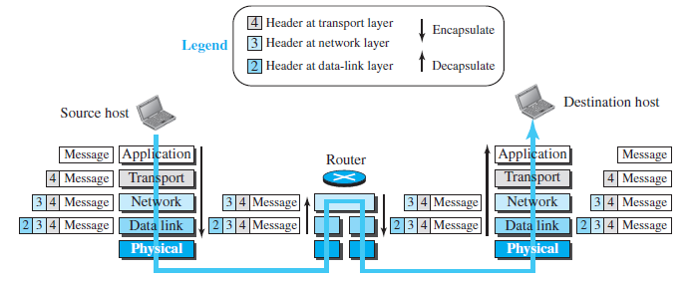
Encapsulation and Decapsulation
2.<number>

Slide 16
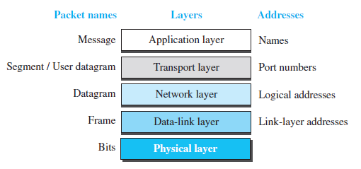
Addressing in the TCP/IP protocol suite
2.<number>

Slide 17
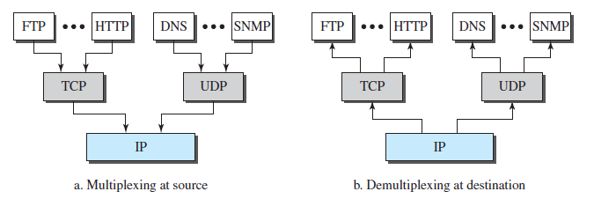
Multiplexing and demultiplexing
2.<number>

Slide 18
Example 2.1
In Figure 2.19 a node with physical address 10 sends a frame to a node with physical address 87. The two nodes are connected by a link (bus topology LAN). As the figure shows, the computer with physical address 10 is the sender, and the computer with physical address 87 is the receiver.
2.<number>

Slide 19

Figure 2.19 Physical addresses
2.<number>

Slide 20
Example 2.2
Most local-area networks use a 48-bit (6-byte) physical address written as 12 hexadecimal digits; every byte (2 hexadecimal digits) is separated by a colon, as shown below:
07:01:02:01:2C:4B
A 6-byte (12 hexadecimal digits) physical address.
2.<number>

Slide 21
Example 2.3
Figure 2.20 shows a part of an internet with two routers connecting three LANs. Each device (computer or router) has a pair of addresses (logical and physical) for each connection. In this case, each computer is connected to only one link and therefore has only one pair of addresses. Each router, however, is connected to three networks (only two are shown in the figure). So each router has three pairs of addresses, one for each connection.
2.<number>

Slide 22

Figure 2.20 IP addresses
2.<number>

Slide 23
Example 2.4
Figure 2.21 shows two computers communicating via the Internet. The sending computer is running three processes at this time with port addresses a, b, and c. The receiving computer is running two processes at this time with port addresses j and k. Process a in the sending computer needs to communicate with process j in the receiving computer. Note that although physical addresses change from hop to hop, logical and port addresses remain the same from the source to destination.
2.<number>

Slide 24

Figure 2.21 Port addresses
2.<number>

Slide 25

Note
The physical addresses will change from hop to hop,
but the logical addresses usually remain the same.
2.<number>

Slide 26
Example 2.5
A port address is a 16-bit address represented by one decimal number as shown.
753
A 16-bit port address represented
as one single number.
2.<number>

Slide 27
2-2 THE OSI MODEL
Established in 1947, the International Standards Organization (ISO) is a multinational body dedicated to worldwide agreement on international standards.
An ISO standard that covers all aspects of network communications is the Open Systems Interconnection (OSI) model.
It was first introduced in the late 1970s.
2.<number>

Slide 28

Figure 2.2 Seven layers of the OSI model
2.<number>

Slide 29
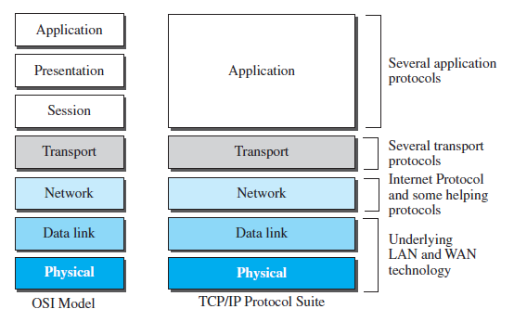
OSI vs TCP/IP
2.<number>

Slide 30
Lack of OSI model’s success
The OSI model appeared after the TCP/IP protocol suite. It thought that the TCP/IP protocol would be fully replaced by the OSI model.
It did not happen because of several reasons.
  First, OSI was completed when TCP/IP was fully in place and a lot of time and money had been spent on the suite; changing it would cost a lot.
  Second, some layers in the OSI model were never fully defined.
  When implemented OSI did not show a significant improvement in performance.
2.<number>

